Slide 1

Paper Airplanes :
Advanced Python Project
PRESENTED BY :
SAMAR MOUSSA

Slide 2
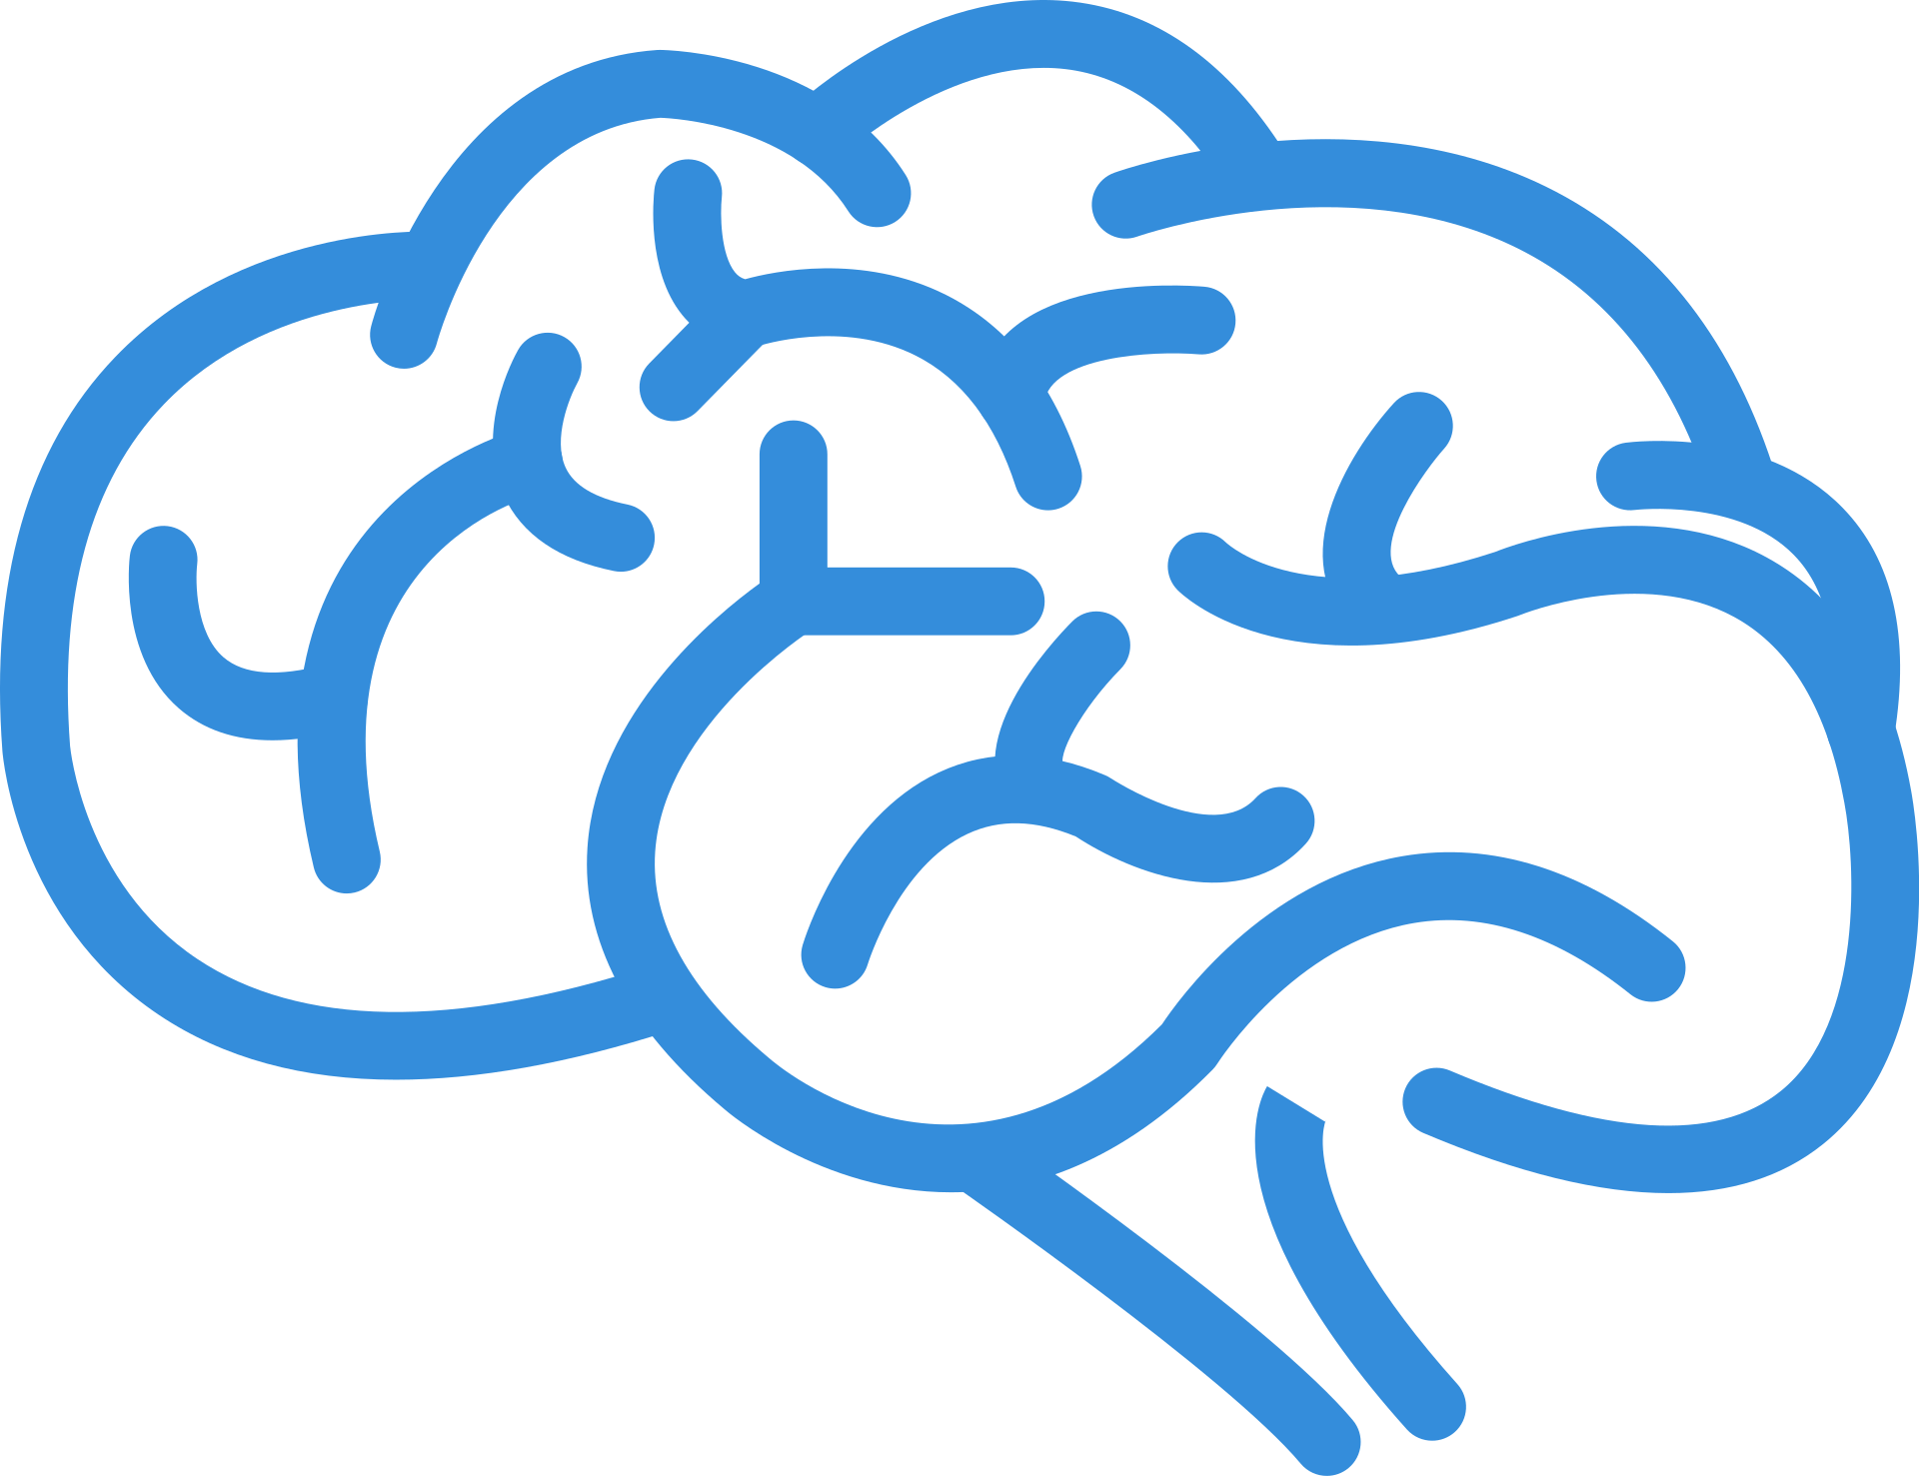
TODAY'S DISCUSSION:
MUSIC AND MENTAL HEALTH SURVEY
TOPICS TO COVER
  Music and Mental Health relationship survey results.
  Discussing the relationship between music and mental health for a sample of more than 730 individuals.
  Data set is used from Kaggle

Slide 3
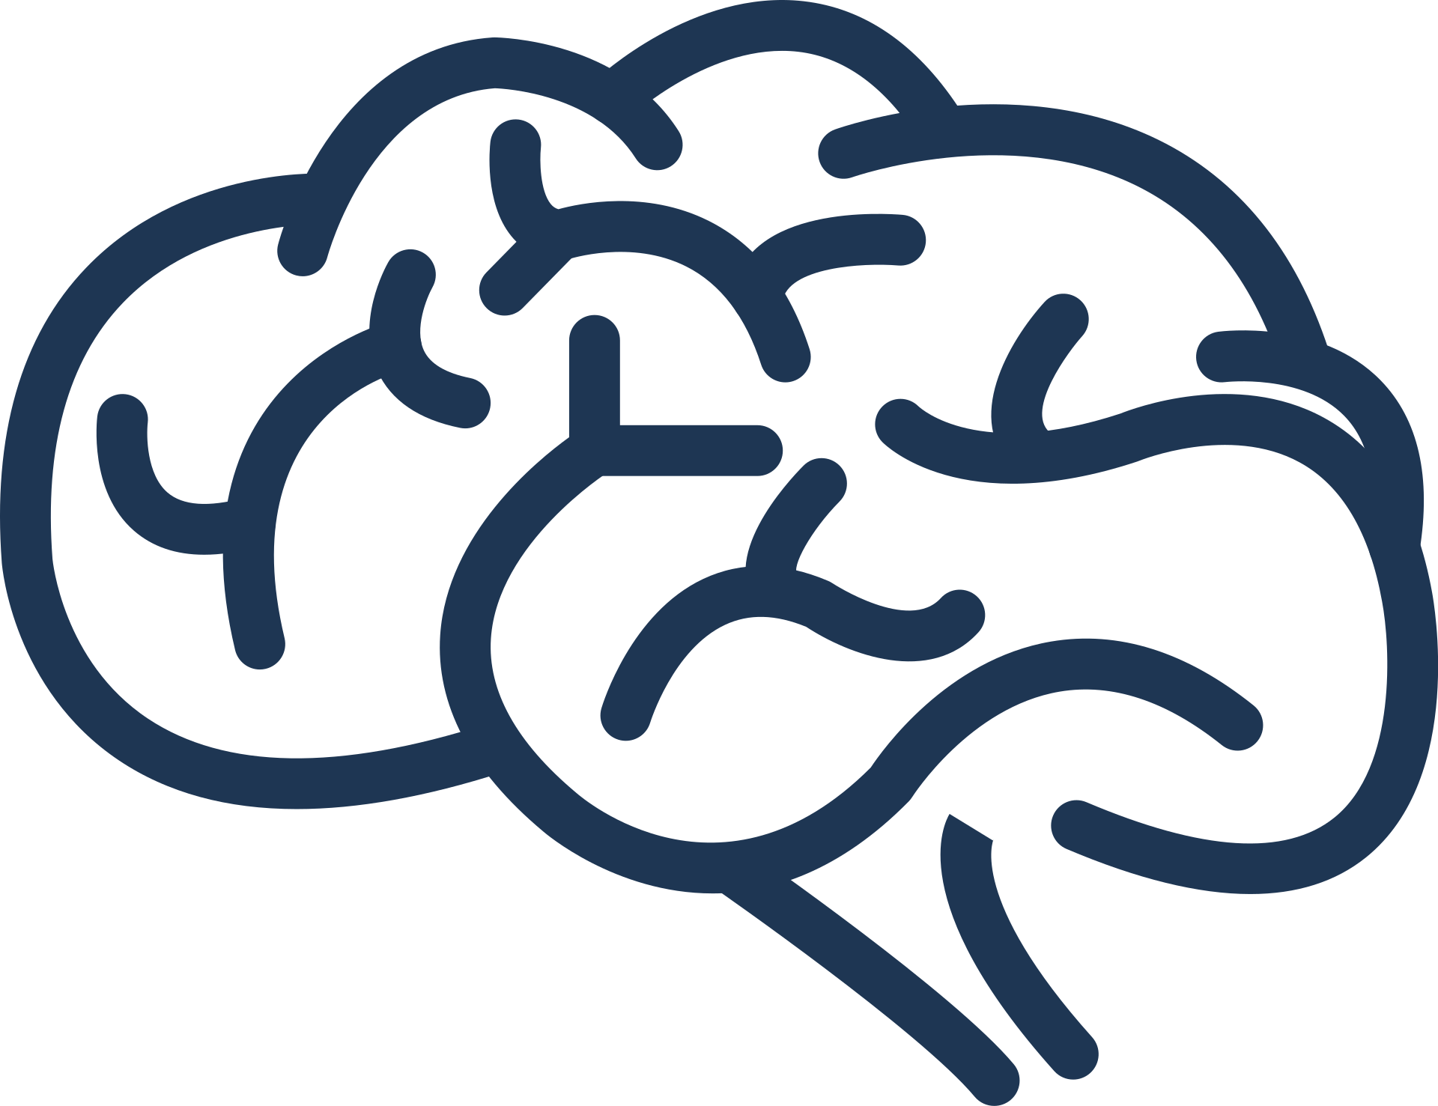
SO, MORE INFO ABOUT OUR DATASET?

Slide 4
HOW WAS IT GENERATED?
Information about the dataset
HOW BIG IS THE DATASET?
it was through a survey using google forms for more than 738 people through different platforms, from different genres and the affect on their Anxiety, insomnia and depression
the dataset is taken as a survey sample of more than 738 people listening to music while doing different activities
WHAT IS TAKEN INTO CONSIDERATION?
  Genres
  service platform
  foreign music
  while working
  Music effect
  depression, anxiety and insonmia rates in each person

Slide 5
Using Python

Slide 6
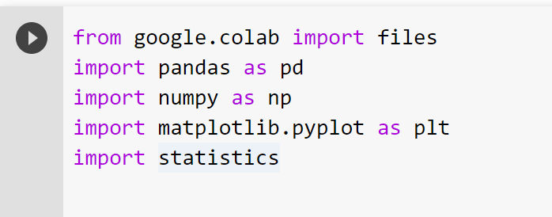
METHODOLOGY
1- Upload the right libraries pandas, numby and Matplotlib and statistics

Slide 7
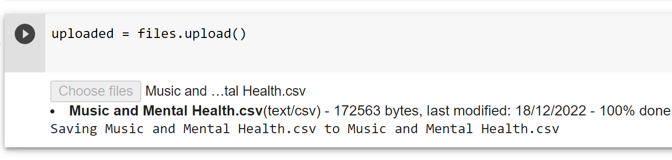
METHODOLOGY
2- Uploading csv file to google collab

Slide 8
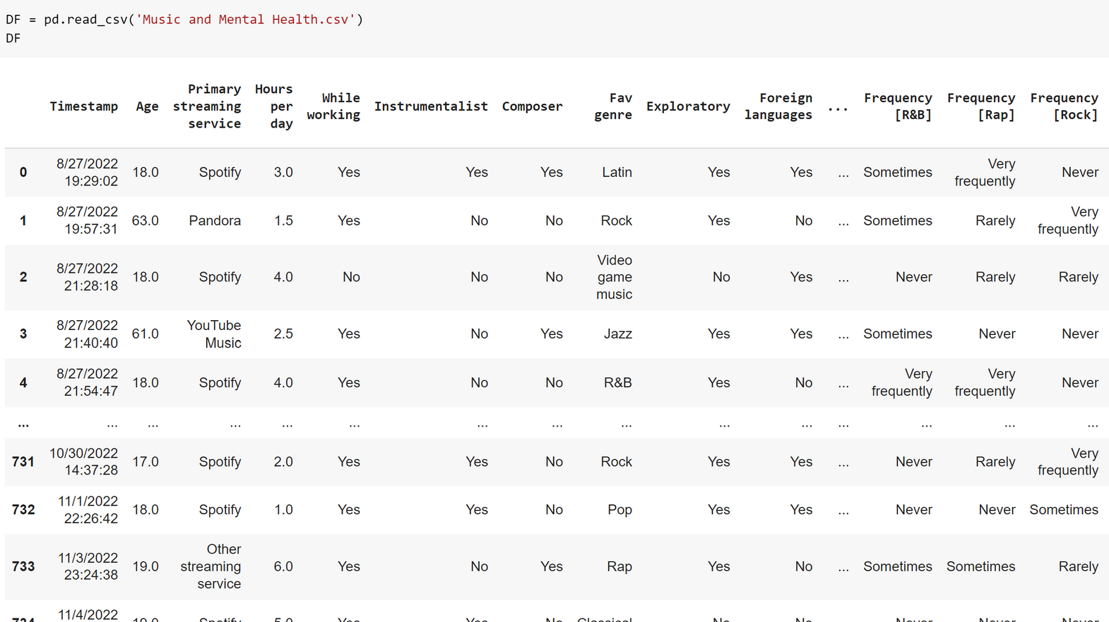
METHODOLOGY
3- reading the csv file using the Pandas Library

Slide 9
Basic statistics

Slide 10
BASIC STATISTICS OF MY DATASET
DESCRIBING THE DATASET
MEAN,VARIANCE AND
STANDARD DEVIATION
VALUES OF THE DATASET
DF.describe()
DF.value_counts()
DF.mean()
DF.var()

Slide 11
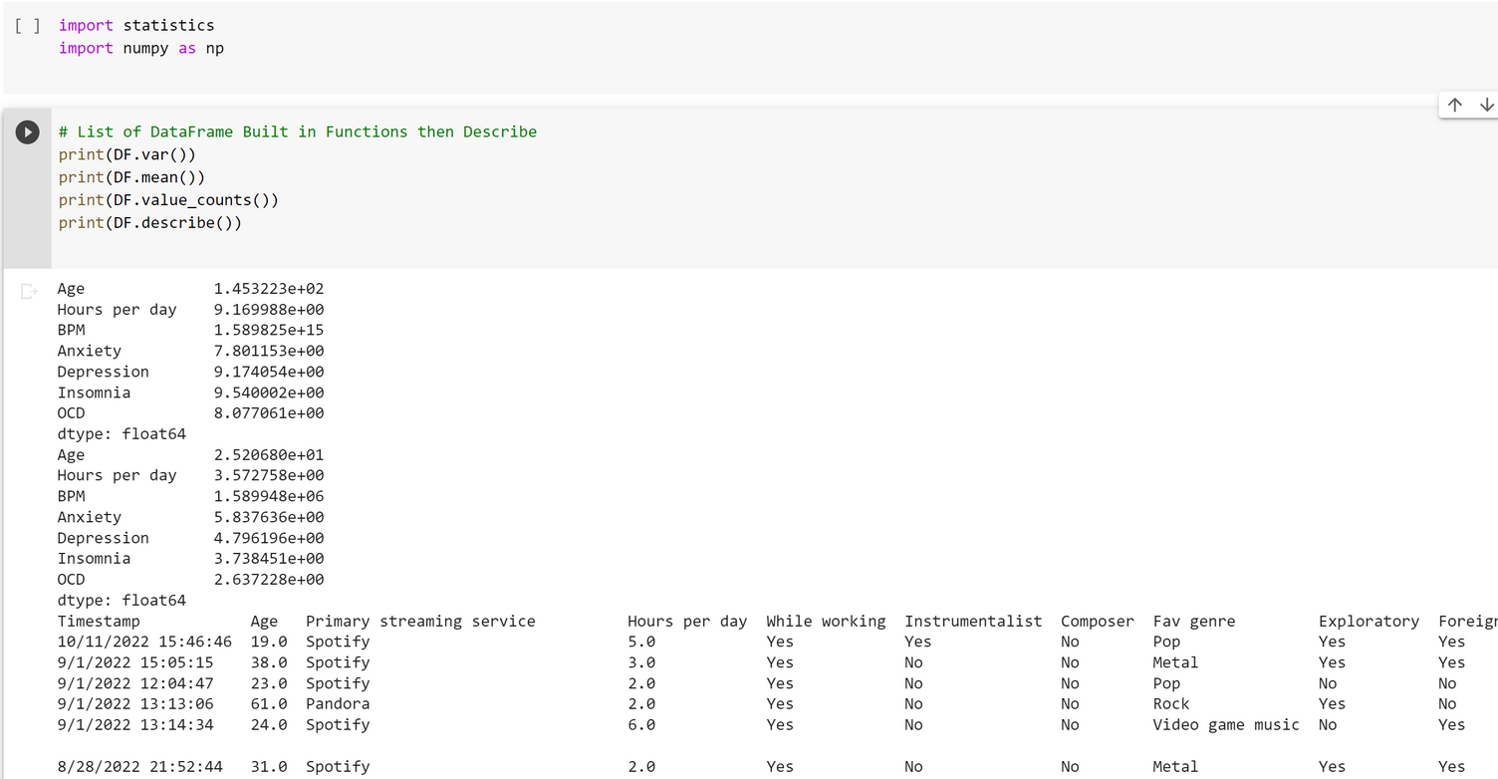
BASIC STATISTICS
4- using describe() we can get the basic statistics for each column

Slide 12
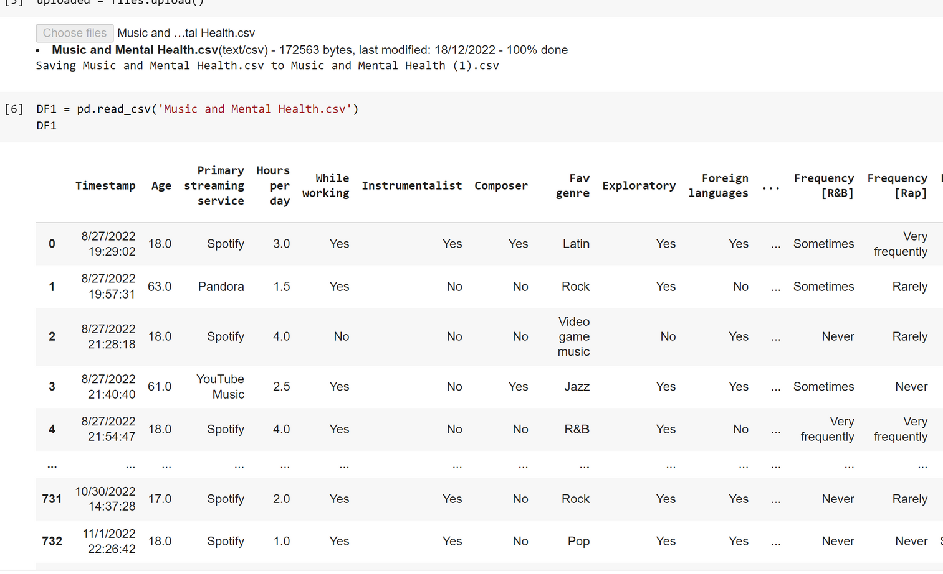
STATISTICAL TEST:SHAPIRO
5- we are trying to perform a statistical test here which is Shapiro test , to calculate and mesure the fitness of data and to see if it is normally distributed
First we uploaded the dataset and caculated basic statistics and then did the shapiro test

Slide 13
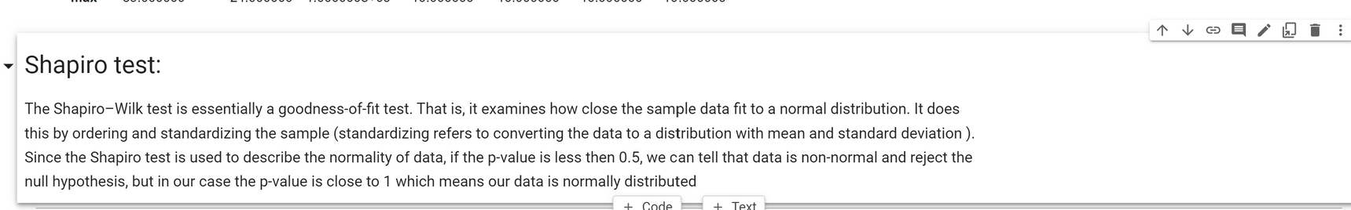
WHY SHAPIRO TEST?
FITNESS OF DATA
  Measure normal distribution
  how data is close to normal

Slide 14
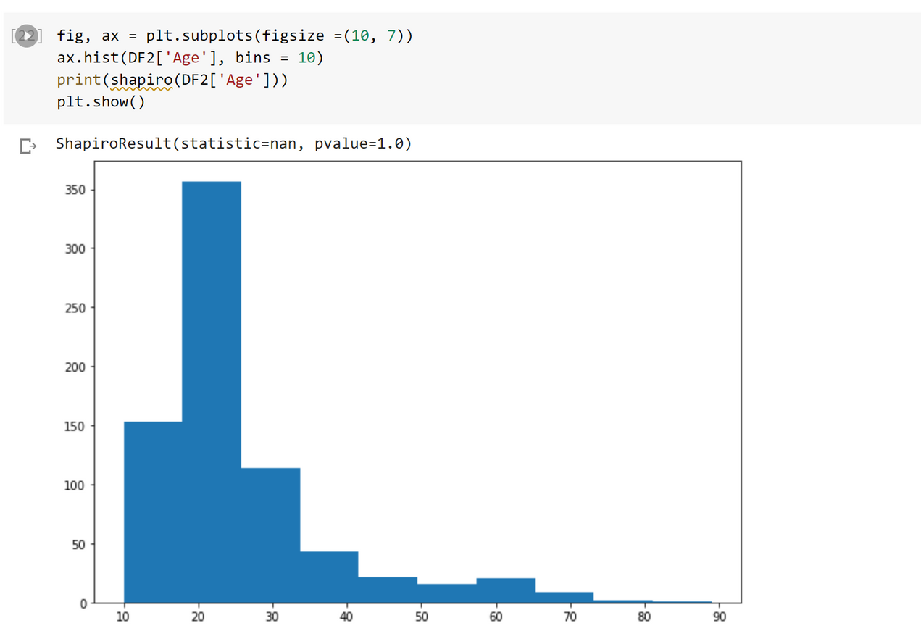
SHAPIRO TEST ON AGE
AGE
  We can see that most of the values are for teens and people between 15 and 30 years old

Slide 15
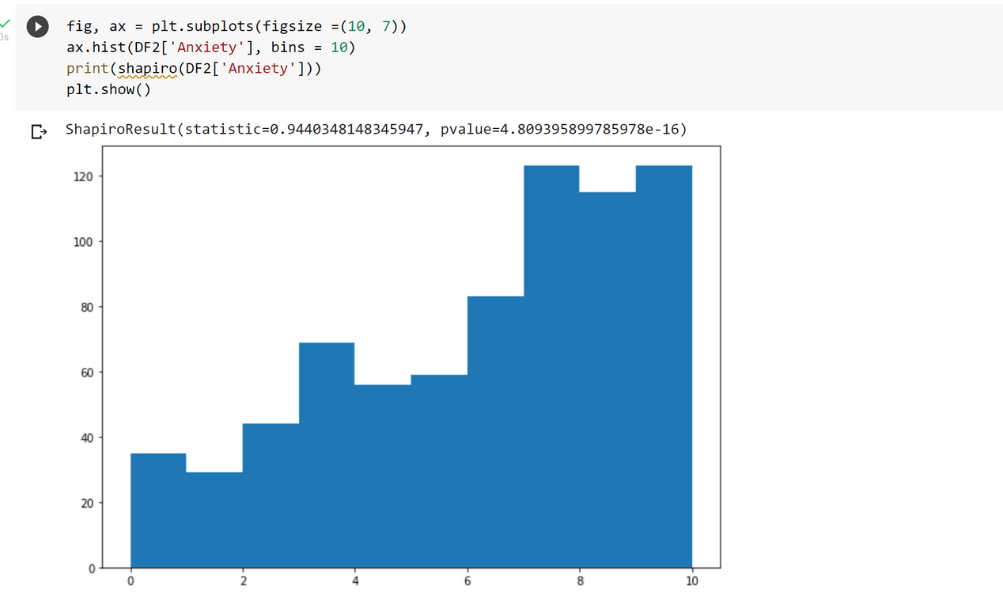
SHAPIRO TEST ON ANXIETY
ANXIETY
  different ranges shows that people from all anxiety level listen to music, but people with higher anxiety levels are more likely to listen to music

Slide 16
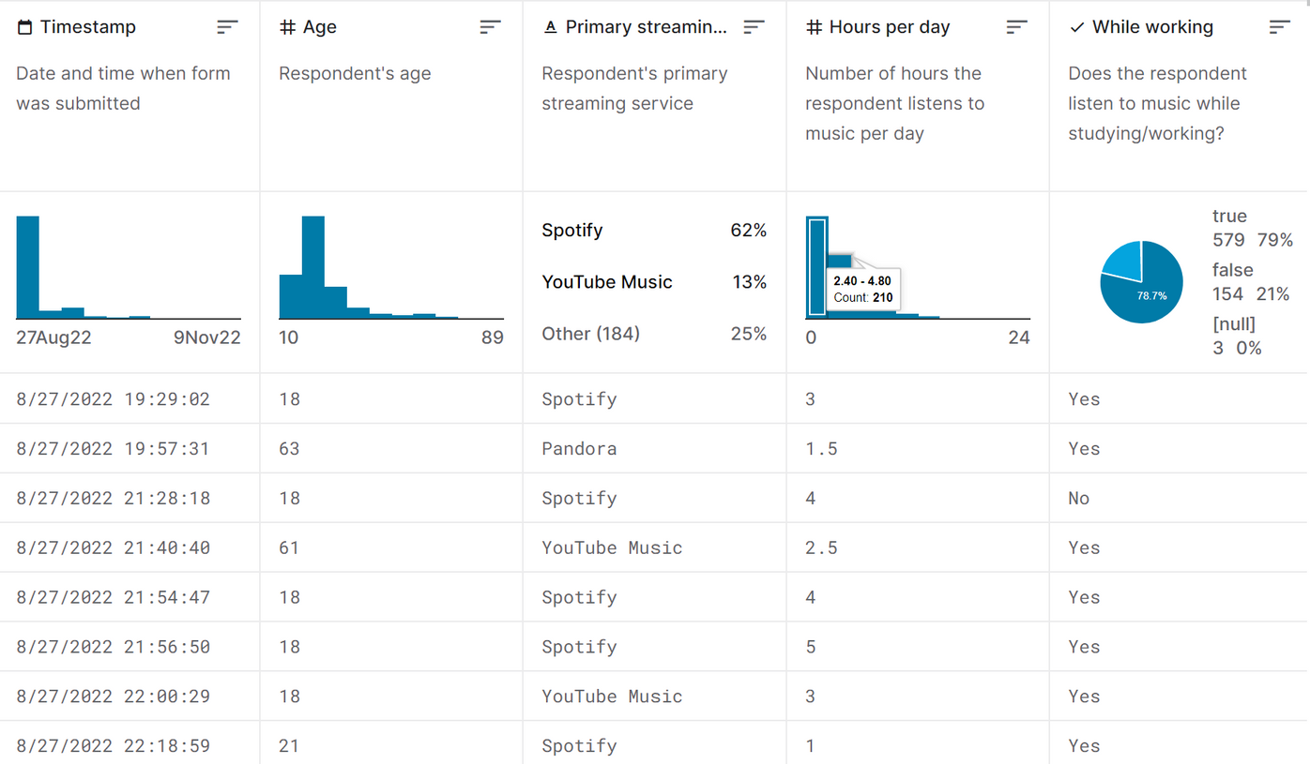
WHATDOES OUR DATA SAY?
RESULTS
  most of the data taken between 27th of August to 9th of November 2022
  Majority of the people of this sample are around 18 - 26
  62% are using Spotify are their main music service platform
  338 out of 738 listen to music between 0 and 2,4 hours
  210 listen to music between 2.4 to 5 hours per day
  78.7% of them listen to music while working
  55% listen to music in foreign language

Slide 17
Dataset Link:
https://www.kaggle.com/datasets/catherinerasgaitis/mxmh-survey-results
REFRENCES

Slide 18
Thank you for listening!

